Slide 1
Innovation Techniques
Workshop
Bruce Bland
Date: 22/08/2018

Slide 2
Innovation Techniques
To define a set of innovation methods that can be used anywhere!
What's the question? And how can I visualise it?
Merging existing ideas
Resource mapping
Divergence, convergence methods
Evolution of existing, understanding to need for research
Hammer problem, removing bias from decisions
Case studies, multiple design paradigms
Feedback loops
Innovation Pipelines – How it should work!
Summary
You WILL need PEN and PAPER PAD →
Notes:
From Sandwiches to Software
Item development
Design and Planning Gardens
Designing Buildings

Slide 3
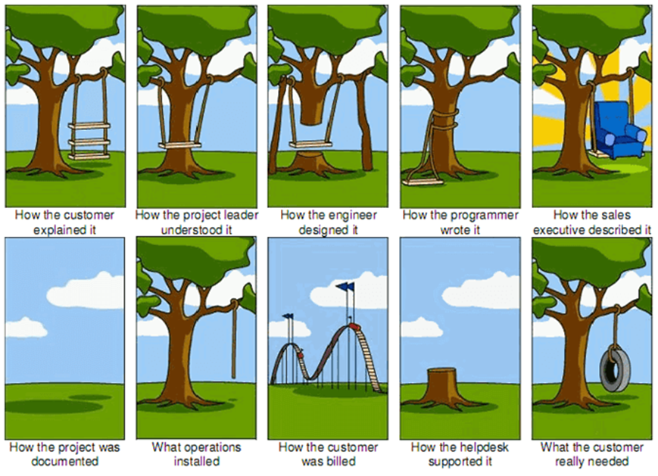
What's the question ?
Definition of the goal:
Accurate statement of the goal(s)
Write a list
Draw a mind map
Accurate statement of the constraints – What cannot be used
How do we know when its finished?
Multiple goals, can the all be reached?
Notes:
Goal
Making the objective a definitive statement
Making a list of objectives
Constraints that must be adhered to
Timing issues that must be managed (Critical Path) – Will discuss the timing constraints with Titanic problem

Slide 4
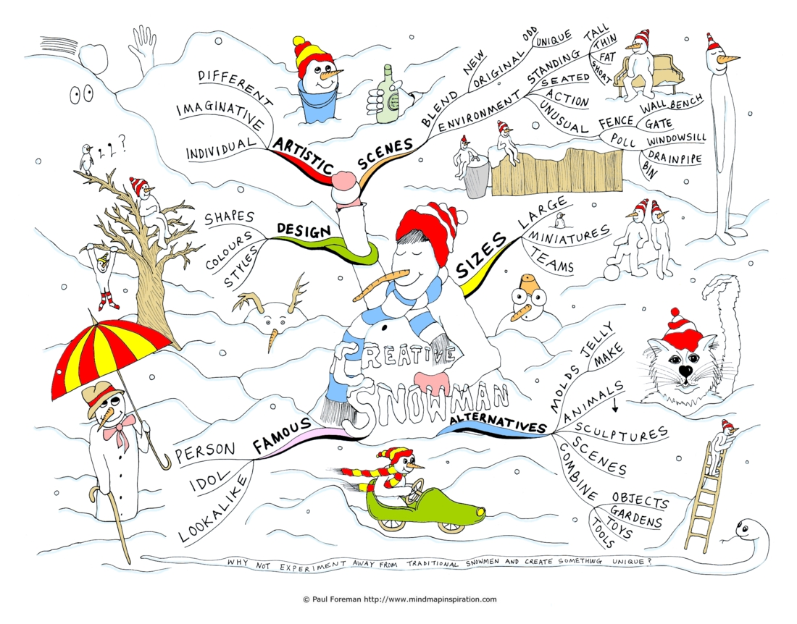
Making maps of problem to be solved
Notes:
The key is often visualisation of the problem.
Also good to have some common key starting points:
- Design, Alternatives, Sizes, Shapes, Colour, Style, Environment, Time

Slide 5
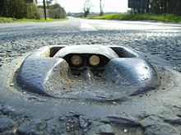

Merging existing technologies
Process
Define goal
Create some designs
Merge designs
Test / Check meets goal
Challenge 1
New type of sandwich
Step 1: Write down five sandwiches you like
Step 2: Write down five new ingredients you like
Step 3: Write down two bread types
Step 4: Now merge types, ingredients to make new ones (Need at least two please!)
Time: 5 Mins
Item 1
Item 2
Notes:
Simple examples:
Cats Eyes for road safety
Cornish pasties
Cautions: Ensure goal is defined: Large sandwich/or tasty sandwich/or fat free sandwich/ or easy to carry

Slide 6
Resource Mapping
Mind Map
What do I have?
Histories
Time?
Scenarios
Testing?
Process
Define Goal
Map all Resources
Merge resources in map
Cross off resources to be avoided
Challenge 2
Titanic has just begun to sink what do you do?
Step 1: As individuals write the goal, and then all resources that might have been on the decks or in the ship which might help you survive.
Step 2: Cross off the non starters, and see if what you get left will help you.
Time: 5 Mins
Notes:
Whats the goal? Need to define it well or you wont survive.
Hints: You do have some time before the ship sinks, and life boats have started to be loaded.
Note: The time it took the Titanic to sink after hitting the iceberg was 2 hours and 40 minutes.

Slide 7
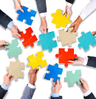
Divergence-Convergence
Team process
Each team member creates a new design (Divergence)
All ideas pooled in meeting to select the best (Convergence)
Challenge 3
Pair up, and decide which is the best.
Need to decide what criteria make one sandwich better than the other
Time: 5 Mins

Slide 8
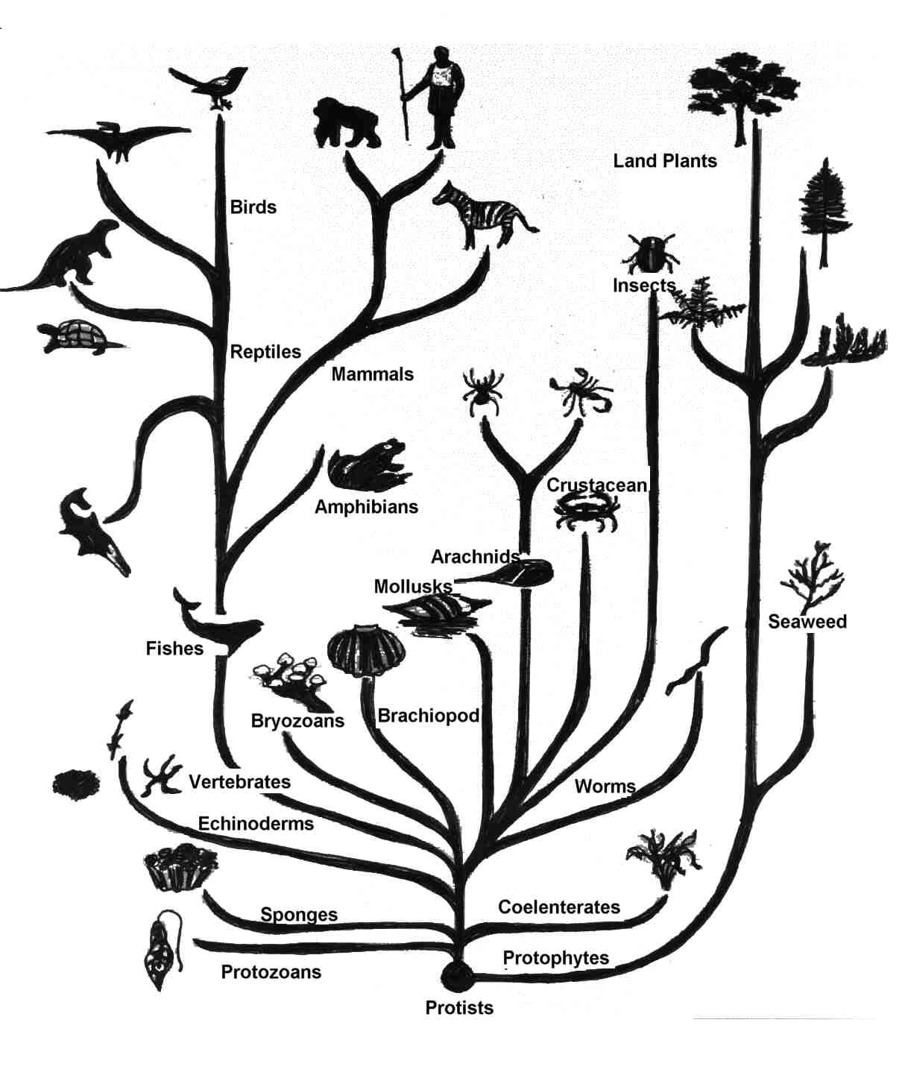
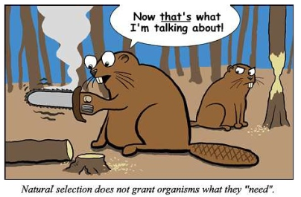
Learning from Nature
Evolution is a super set of previous methods:
Merge (Breed)
Cross off the bad ones (Natural selection)
Combine the good ones (Merge best)
Requires iterations to be effective
Poor for software development (Opportunity costs)

Slide 9
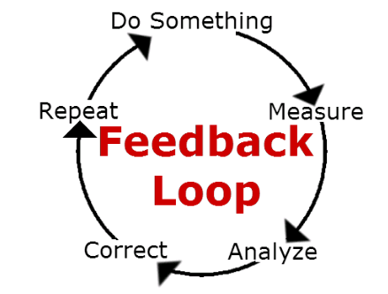
Feedback Loops
Which methods worked best?
Will repeating process help?
Who did best at what, is someone better suited to solve the problems?
What solutions could be fixed with minor changes?
Challenge 4
Step 1: Take best sandwiches so far in each pair
Step 2: Try to improve them (given we now have a better understanding of the problem)
Step 3: Now write down the best again
Time: 5 Mins
Notes:
Game theory – The further into a game you are, the less parameters you have to worry about.

Slide 10
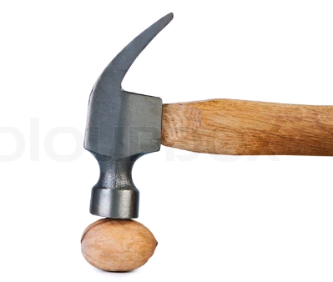
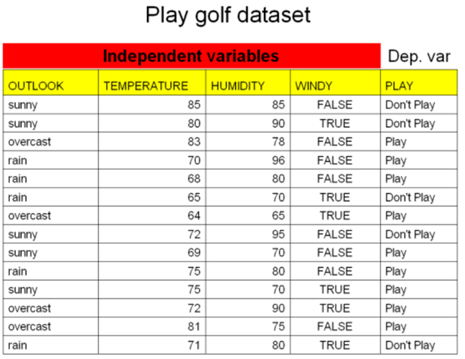
Hammer problem, removing bias from decisions
“a Birmingham screwdriver”
is a cognitive bias that involves an over-reliance on a familiar tool
Remove bias from decision making approach
Lists pros and cons
Decision matrix
Note: The first recorded statement of the concept was Abraham Kaplan's, in 1964: "I call it the law of the instrument, and it may be formulated as follows: Give a small boy a hammer, and he will find that everything he encounters needs pounding."

Slide 11
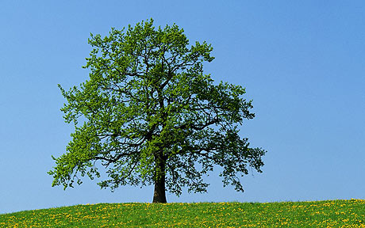
Poor innovation
A simple question ….
Where does the mass of a tree actually come from?

Slide 12
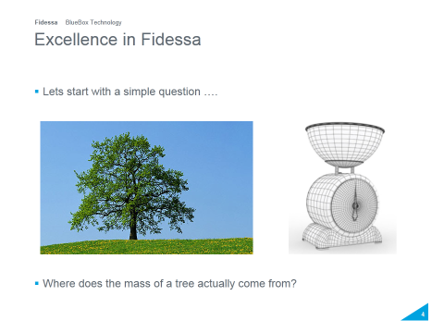
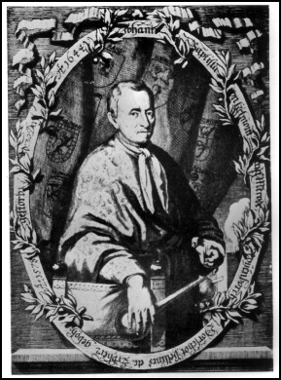
Excellence – Discovering new ideas
Jan Baptist van Helmont
Notes:
Van Helmont was a man of contradictions. On the one hand, he was a disciple of Paracelsus (though he scornfully repudiated his errors as well as those of most other contemporary authorities), a mystic and alchemist. On the other hand, he was touched with the new learning based on experiment that was producing men like William Harvey,Galileo Galilei and Francis Bacon. Van Helmont was a careful observer of nature; it can be inferred that from his analysis of data gathered in his experiments suggested he had a concept of the conservation of mass. He performed an experiment to determine where plants get their mass. He grew a willow tree and measured the amount of soil, the weight of the tree and the water he added. After five years the plant had gained about 164 lbs (74 kg). Since the amount of soil was basically the same as it had been when he started his experiment, he deduced that the tree's weight gain had come from water. Since it had received nothing but water and the soil weighed practically the same as at the beginning, he argued that the increased weight of wood, bark and roots had been formed from water alone. However, this "deduction" is incomplete, as a large proportion of the mass of the tree comes from atmospheric carbon dioxide, which, in conjunction with water, is turned into carbohydrates via photosynthesis.

Slide 13
Innovation – How to avoid mistakes
Dragons den (Shark tank – US)
Many new innovations
Not all good ones
Need to build a framework to prevent poor choices
Judging new ideas
Decision matrix approach
The analytic hierarchy process (AHP) is a structured technique for organizing and analysing complex decisions, based on mathematics and psychology. It was developed by Thomas L. Saaty in the 1970s and has been extensively studied and refined since then.

Slide 14
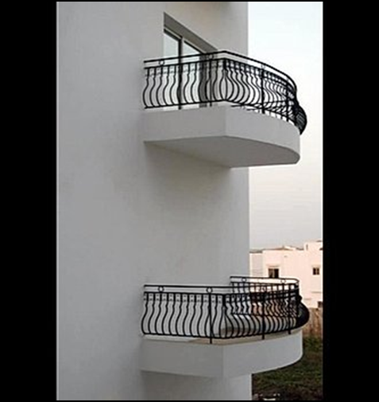
Case studies, multiple design paradigms
Case Studies (Testing)
If no simple solution – Or left with two possible
Multiple design paradigms
Often where merge cannot be used

Slide 15
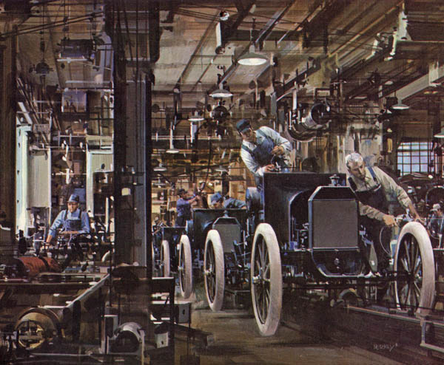
Innovation Pipeline
Common innovation pipeline approach
Marketing
Development
Distribution
Research Teams
Research Team
Research Team

Slide 16
Innovation Pipelines
Total job is broken down into groups of simple tasks, permitting specialization of labour skills.
Standardization creates opportunities for predictability and preplanning and provides uniformity in service quality
What do other companies do in this space?
Research Teams
Stimulating new innovative ideas (Technology, and business)
Creative teams – Problem solvers
Demonstration of new ideas to clients
Prototype, and re-prototype (Long prototyping stage, as manufacturing expensive)
Managing IPR – Patents, customer feedback

Slide 17

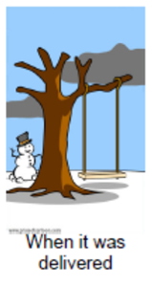
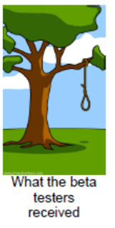
Summary
What happens next …..
Summary
Merge, Resource Mapping, Divergence-Convergence, Evolution methods
Definition of goals, and objectives, and judging best ideas.
Innovation pipelines – Integration with the rest of the company

